Slide 1



DC house
View in Power BI
Last data refresh:
8/11/2022 8:03:54 PM UTC
Downloaded at:
8/12/2022 6:44:13 AM UTC

Slide 2
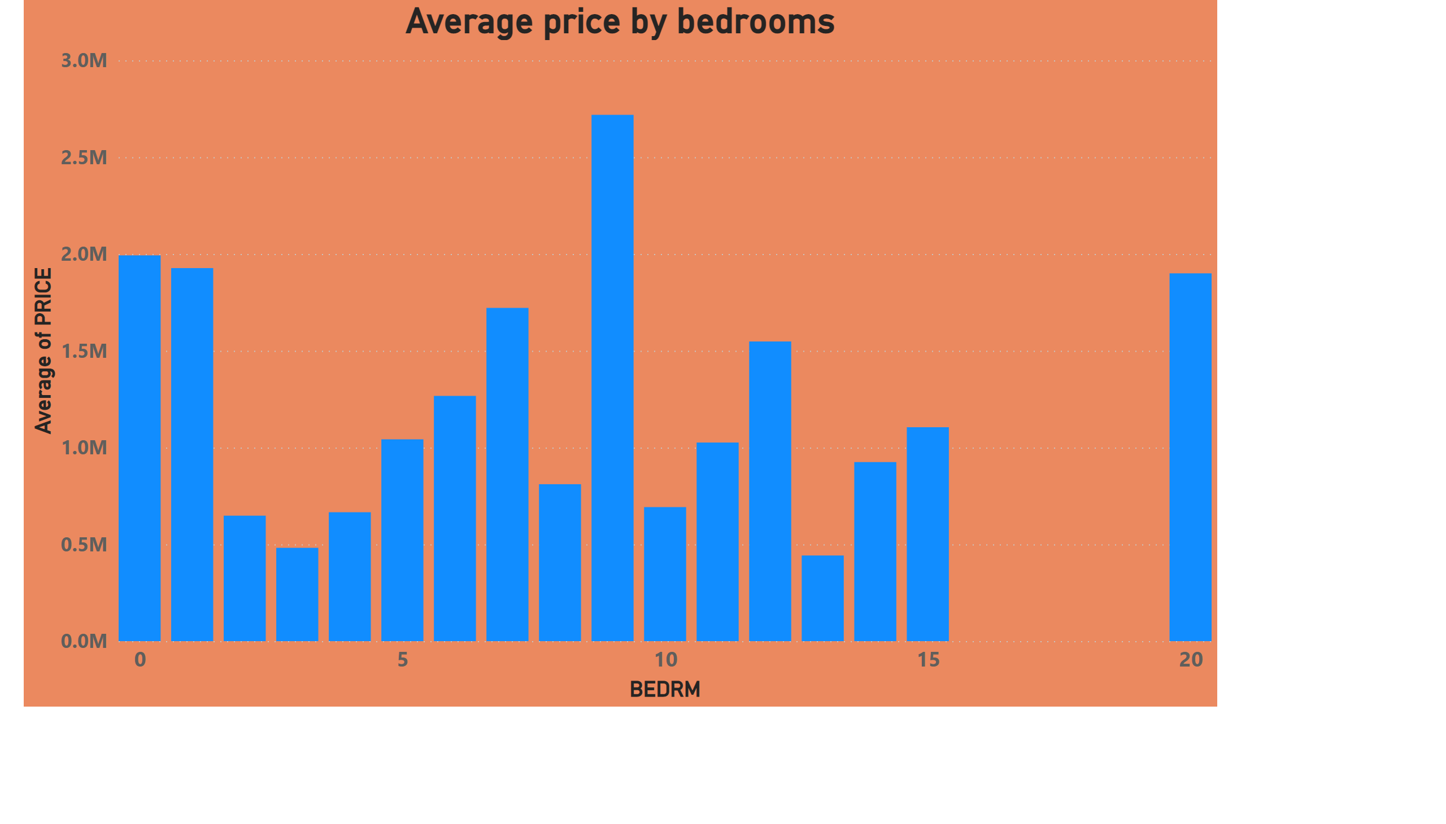
Page 1
Notes:
Average price by bedrooms
No alt text provided

Slide 3
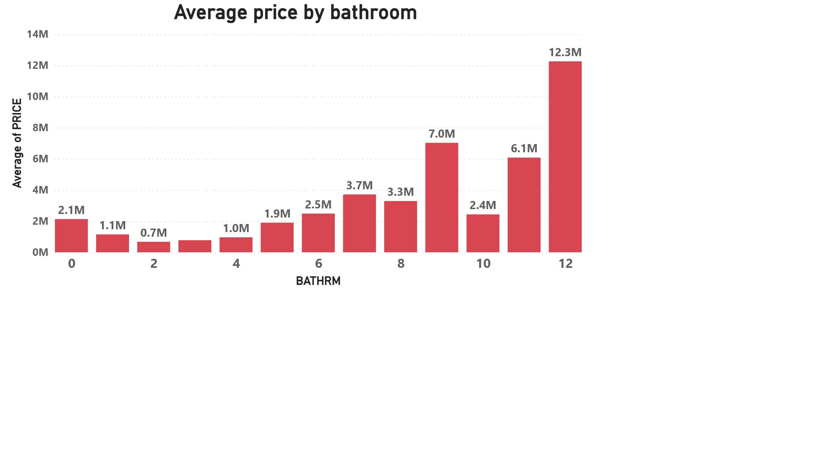
Page 2
Notes:
Average price by bathroom
No alt text provided

Slide 4
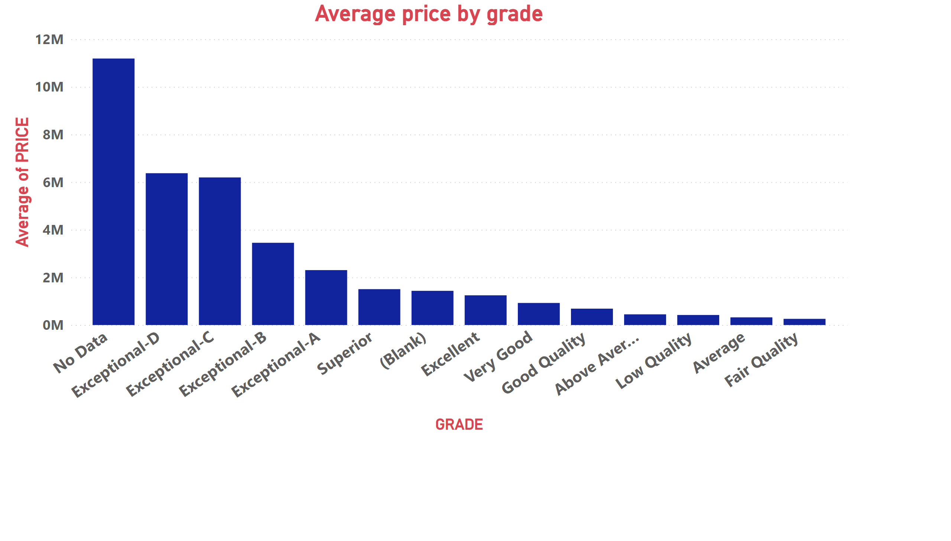
Page 3
Notes:
Average price by grade
No alt text provided

Slide 5
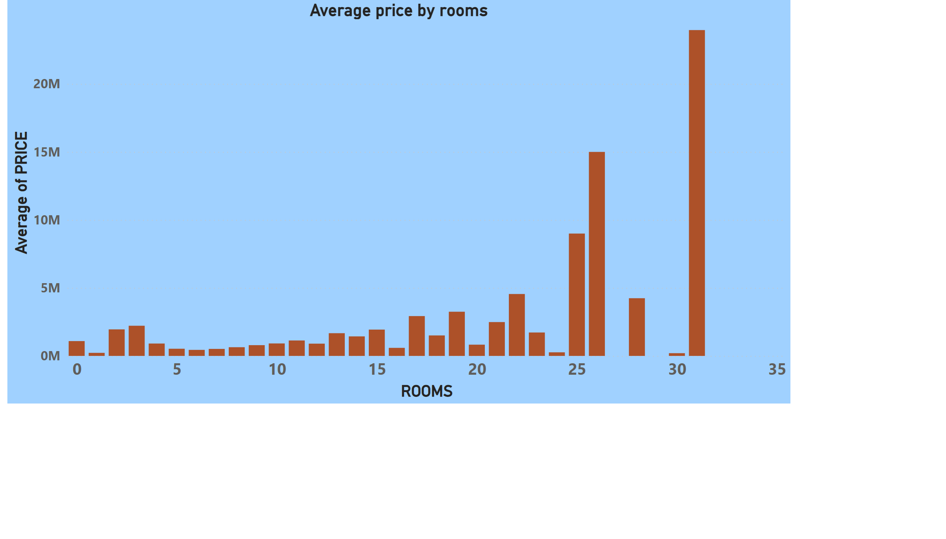
Page 4
Notes:
Average price by rooms
No alt text provided

